Slide 1

Intelligent Intrusion Detection System Using Face Recognition and Cryptographic Security
CSA5113-Cryptography and Network Security
Course Faculty : Dr. R. Dharani, Professor/Edge Computing,
SIMATS Engineering, SIMATS
Presented By:
Sreeshanth Basineni (192372238)
C. Bhuvaneswar Reddy (192372253)
Kartheeka Repalle (192372289)

Slide 2

Agenda
Abstract
Introduction
Literature Review
Problem Statement
Objectives
System Architecture
Modules
Implementation
Results & Discussion
Conclusion
Future Enhancements
References

Slide 3
Abstract
The Intelligent Intrusion Detection System Using Face Recognition and Cryptographic Security is a smart security system developed to automatically detect unauthorized persons and securely manage intrusion evidence. Traditional CCTV systems mainly record activities and depend on continuous human monitoring, which may delay the detection and response to security incidents.
The proposed system uses three modules. Module 1 performs camera monitoring, motion detection, face detection, and face recognition to classify people as authorized or unknown. Module 2 protects the captured intruder image using AES-256 encryption and uses RSA for secure key protection or management. Module 3 maintains secure event logs using SHA-256 and generates HMAC-authenticated alerts before sending notifications to the owner.
Overall, the system combines Artificial Intelligence, Computer Vision, and Cryptographic Security to provide automated intrusion detection, secure evidence storage, tamper detection, and real-time alert notification.

Slide 4
Introduction
Security has become an important requirement for homes, offices, industries, banks, and educational institutions.
Traditional CCTV systems only record videos and require continuous human monitoring.
Existing surveillance systems cannot automatically identify authorized and unauthorized persons.
Captured images and security data are vulnerable to unauthorized access and tampering.
There is a need for an intelligent system that can detect intrusions, recognize faces, and securely protect surveillance data.
The proposed system continuously monitors the area using a camera and detects motion in real time.
It performs face recognition by comparing detected faces with a database of authorized users.
If an unknown person is detected, the system captures the intruder's image as evidence.
The captured image is protected using AES-256 encryption, while RSA secures the encryption key.
Event logs are secured using SHA-256 hashing to ensure data integrity and detect any unauthorized modifications.

Slide 5
Literature Review
S.No | Details of the Journal / Reference | Algorithm / Methodology Used | Advantages | Disadvantages
1 | Viola & Jones (2026) – Rapid Object Detection Using a Boosted Cascade of Simple Features | Haar Cascade Face Detection | Fast, works in real time | Struggles in poor lighting
2 | King, D. E. (2026) – Dlib-ml: A Machine Learning Toolkit | Face Recognition (128-d Encoding) | High accuracy, needs only a few known photos | Slower on low-power devices
3 | NIST FIPS 197 (2025) – Advanced Encryption Standard | AES-256 Encryption | Fast, strong lock for saved photos | Needs safe key storage
4 | NIST FIPS 180-4 (2025) – Secure Hash Standard | SHA-256 Hashing | Quick way to check if data changed | Hashing alone does not hide data
5 | Krawczyk, Bellare & Canetti (2026) – HMAC: Keyed-Hashing for Message Authentication | HMAC Signing | Proves a message is real and unchanged | Needs a shared secret key

Slide 6
Problem Statement
Traditional surveillance systems only record video footage and depend on continuous human monitoring, making it difficult to detect intrusions in real time.
Existing security systems cannot accurately distinguish between authorized and unauthorized individuals, leading to delayed responses and false alarms.
Captured images and surveillance data are often stored without strong protection, making them vulnerable to unauthorized access, data theft, or modification.
Security event logs can be tampered with, reducing the reliability of digital evidence during investigations.
Alert notifications sent through conventional methods may not be authenticated, increasing the risk of fake or modified alerts.
There is a need for an intelligent security system that can automatically detect intrusions, recognize faces, securely protect captured evidence, maintain tamper-proof logs, and send authenticated real-time notifications to the owner.

Slide 7
Objectives
To develop an intelligent intrusion detection system that continuously monitors a protected area using a camera.
To detect motion and identify human faces in real time using computer vision techniques.
To recognize and differentiate authorized and unauthorized persons using face recognition technology.
To protect captured images and sensitive data using AES-256 encryption and RSA for secure key management.
To maintain tamper-proof event logs using SHA-256 hashing to ensure data integrity.
To generate authenticated alert notifications using HMAC and send them to the owner's WhatsApp in real time.
To provide a reliable, secure, and automated surveillance solution for homes, offices, educational institutions, and other high-security environments.

Slide 8
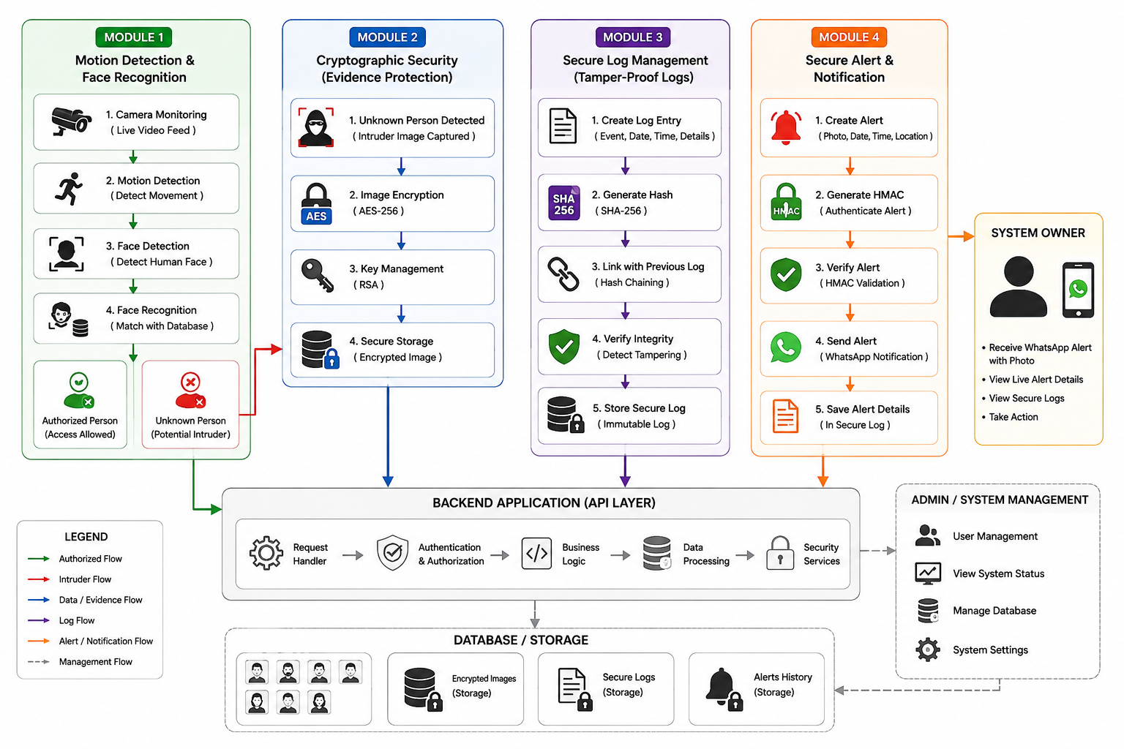
System Architecture

Slide 9
MODULES
Module 1 – Motion Detection and Face Recognition
Module 2 – Cryptographic Evidence Protection
Module 3 – Secure Log Management & Alert Notification

Slide 10
Module 1: Motion Detection and Face Recognition
This module continuously monitors the surveillance area using a camera and detects any movement in real time. When motion is detected, the system automatically identifies the presence of a human face and extracts facial features for further analysis.
The detected face is compared with the database of authorized users using face recognition technology. Based on the matching result, the system classifies the person as an authorized user or an unknown intruder and captures the image for further processing if required.
Key Features:
Continuous camera monitoring
Real-time motion detection
Face detection and recognition
Authorized/Unauthorized identification
Automatic image capture
Timestamp generation

Slide 11
Module 2: Cryptographic Evidence Protection
This module protects the captured intruder images and sensitive surveillance data using advanced cryptographic algorithms. Once an unknown person is detected, the image is encrypted using AES-256 to prevent unauthorized access or data leakage.
The encryption keys are securely managed using RSA, ensuring that only authenticated users can decrypt and access the stored evidence. All encrypted data is stored securely in the database for future investigation.
By applying encryption techniques, this module ensures the confidentiality, privacy, and security of digital evidence throughout its storage and retrieval process.
Key Features
AES-256 image encryption
RSA key management
Secure evidence storage
Data confidentiality
Authorized evidence access

Slide 12
Module 3: Secure Log Management and Alert Notification
This module maintains a secure record of every event occurring within the surveillance system, including motion detection, face recognition results, encryption activities, and alert generation.
Each log entry is protected using SHA-256 hashing, and the logs are linked together to create a tamper-resistant event history. If any log is modified, the system immediately detects the integrity violation.
Before sending the notification, the system generates an HMAC to verify the authenticity and integrity of the alert message. This prevents attackers from modifying or creating fake alerts during transmission.
Key Features
Automatic event logging
SHA-256 hash generation
Tamper-proof log chaining
Log integrity verification
Alert verification
Audit trail maintenance

Slide 13
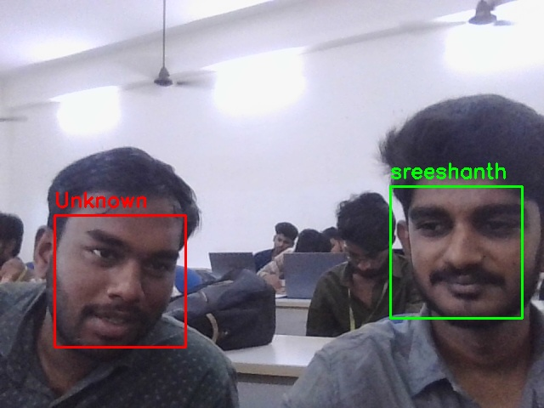
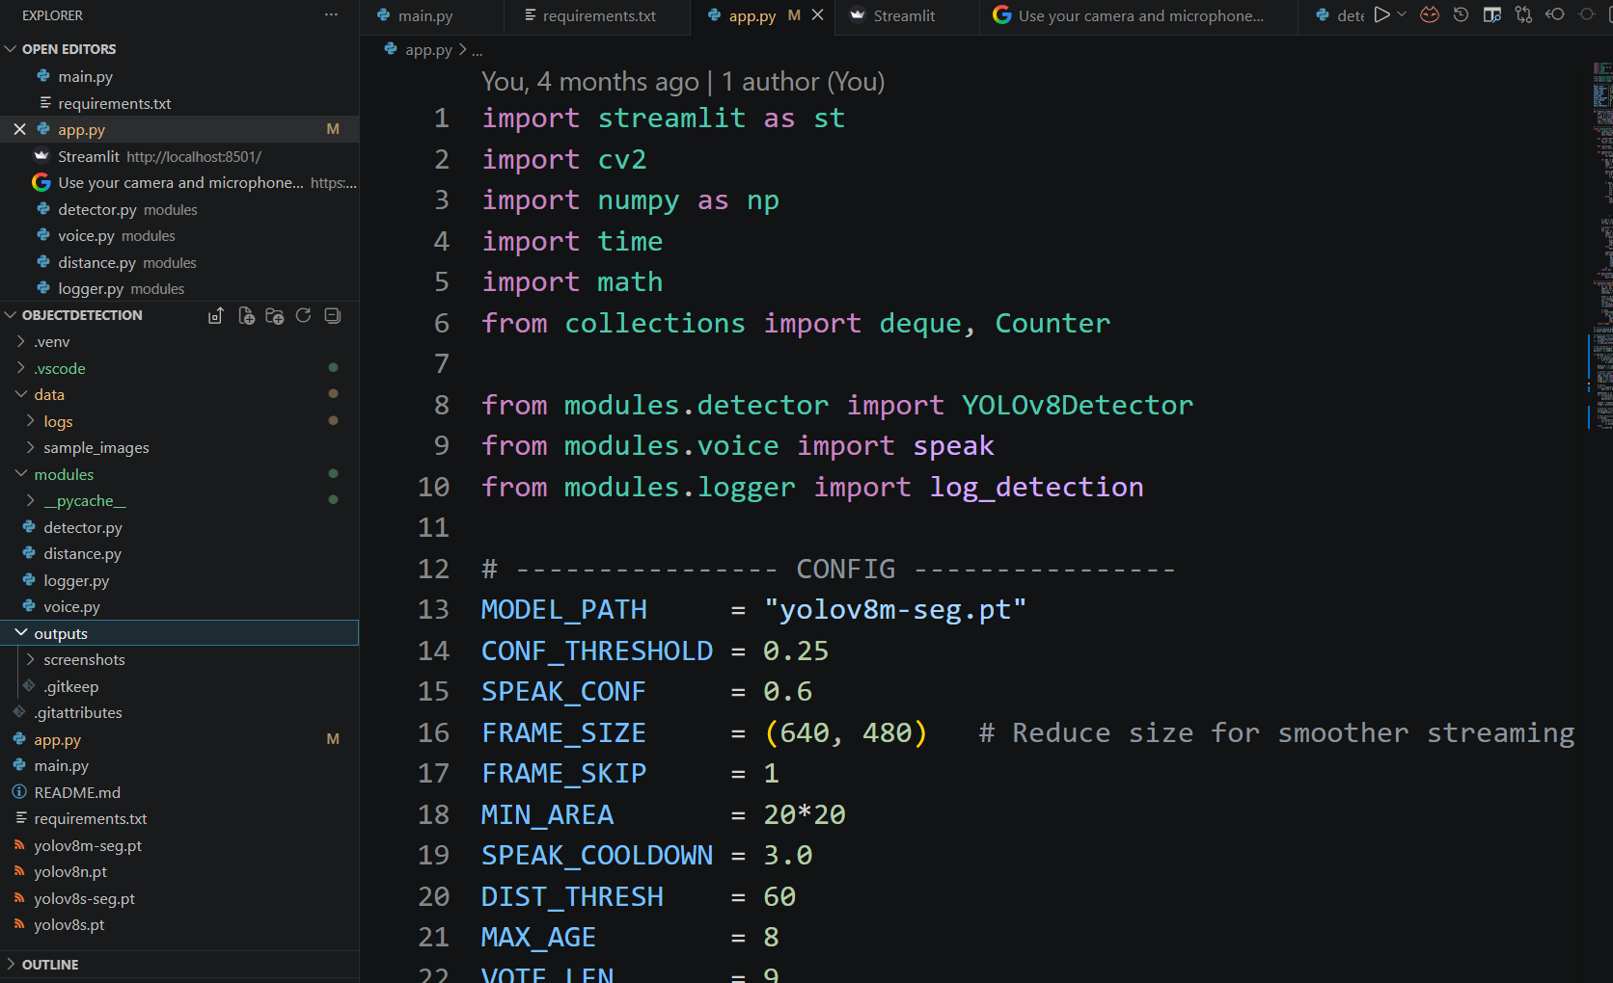
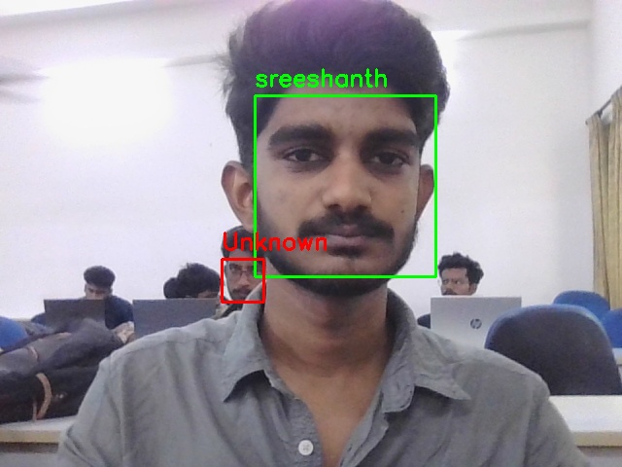
Implementation

Slide 14
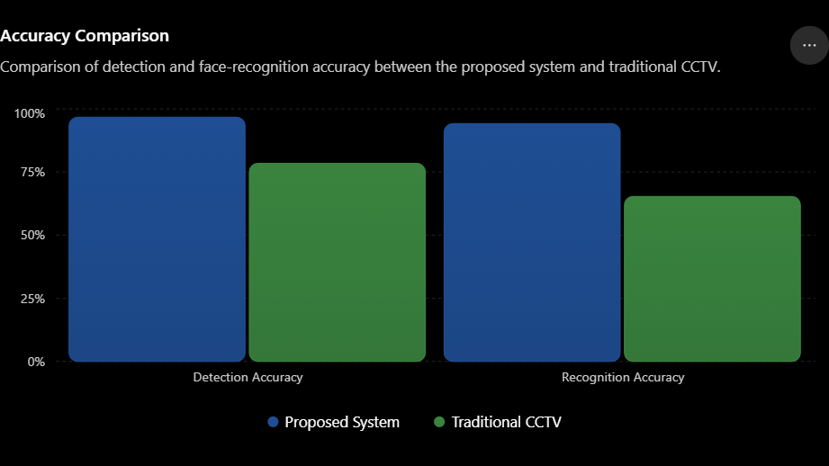
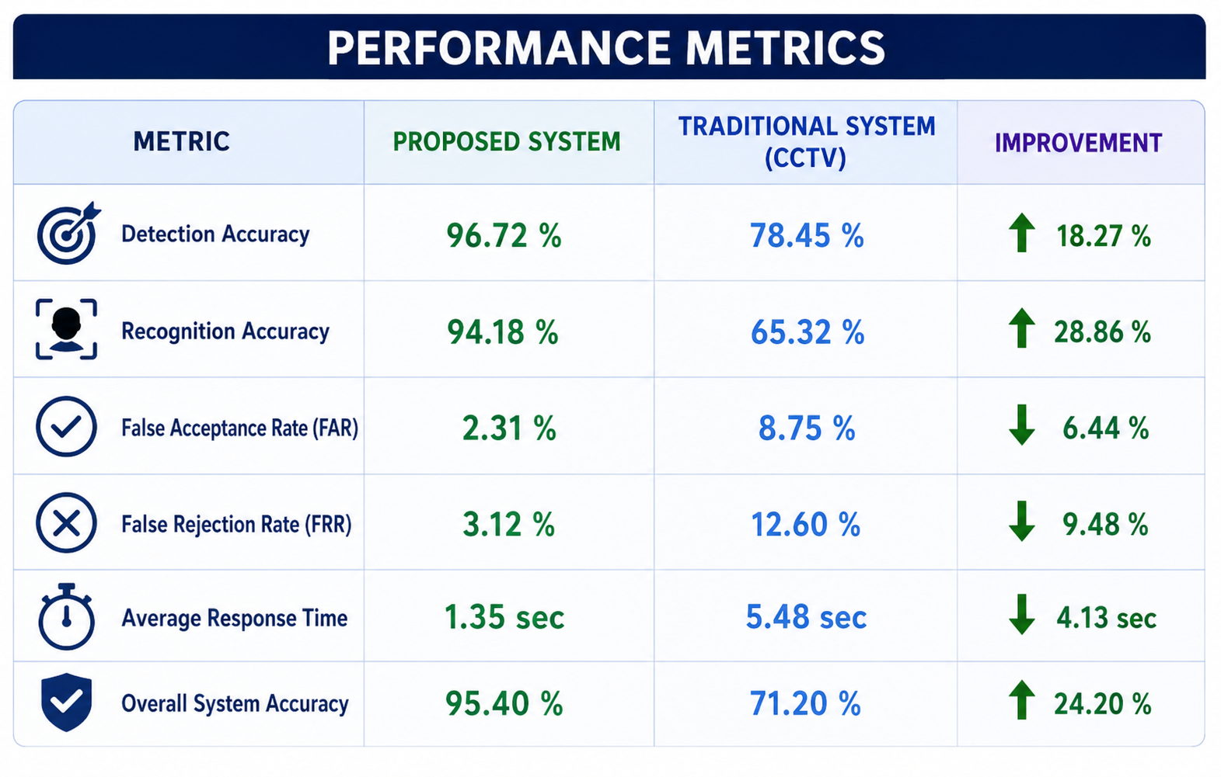
Result & Discussion

Slide 15
Future Scope
Integrate cloud storage to securely store encrypted surveillance data and enable remote access from anywhere.
Develop a mobile application for live monitoring, instant alerts, and remote management of the security system.
Add anti-spoofing (liveness detection) to prevent unauthorized access using photos, videos, or masks.
Support multiple cameras for monitoring large buildings, campuses, industries, and smart cities.
Integrate IoT devices such as smart locks, alarms, and automatic lighting for enhanced security response.
Implement AI-based behavior analysis to detect suspicious activities before an intrusion occurs.
Add voice alerts and emergency siren activation when an unknown intruder is detected.

Slide 16
Conclusion
The Intelligent Intrusion Detection System Using Face Recognition and Cryptographic Security provides a smart and secure solution for real-time surveillance and intrusion detection.
The system automatically detects motion, recognizes authorized users, and identifies unknown intruders without requiring continuous human monitoring.
Advanced cryptographic techniques such as AES-256, RSA, SHA-256, and HMAC ensure the confidentiality, integrity, and authenticity of captured images, event logs, and alert notifications.
Secure evidence storage and tamper-proof logging improve the reliability of digital evidence for future investigation and security analysis.
Real-time WhatsApp notifications enable the owner to respond quickly to potential security threats, enhancing overall safety.
The proposed system is suitable for homes, offices, educational institutions, banks, industries, and other high-security environments.

Slide 17
References
Viola, P. & Jones, M., Rapid Object Detection Using a Boosted Cascade of Simple Features, CVPR, 2026.
King, D. E., Dlib-ml: A Machine Learning Toolkit, Journal of Machine Learning Research, 2026.
NIST, Advanced Encryption Standard (AES), FIPS PUB 197.
NIST, Secure Hash Standard (SHA-256), FIPS PUB 180-4.
Krawczyk, H., Bellare, M., & Canetti, R., HMAC: Keyed-Hashing for Message Authentication, RFC 2104, 2025.
Rivest, R. L., Shamir, A., & Adleman, L., A Method for Obtaining Digital Signatures and Public-Key Cryptosystems, Communications of the ACM, 2025.
William Stallings, Cryptography and Network Security: Principles and Practice, Pearson.
Twilio, WhatsApp Business API Documentation.

Slide 18


